Slide 1
Lesson 2 Operational Amplifiers
任课教师：刘昱朗
Email: yulangliu@hotmail.com

Slide 2
Outline
Technical Contents
Systems 系统
Linear Systems 线性系统
Nonlinear Systems 非线性系统
Technical Terms
Transducer
Gain
Bandwidth
GBP (Gain- Bandwidth Product)

Slide 3


Technical Contents: System
What is a system?
A system is a mapping from an input signal to an output signal.
System
Input Signal $x(t)$
Output Signal y$(t)$

Slide 4
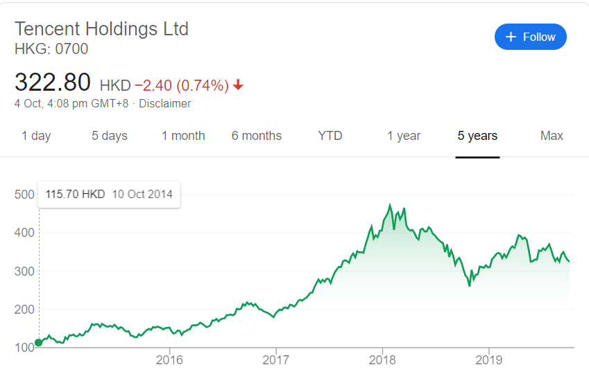
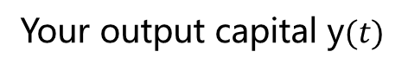

Technical Contents: System
Example 1: Investment Strategy
Your input capital $x(t)$
Your Investment Strategy
Your output capital y$(t)$

Slide 5



Technical Contents: System
Example 2: When you read a book
Your brain

Slide 6
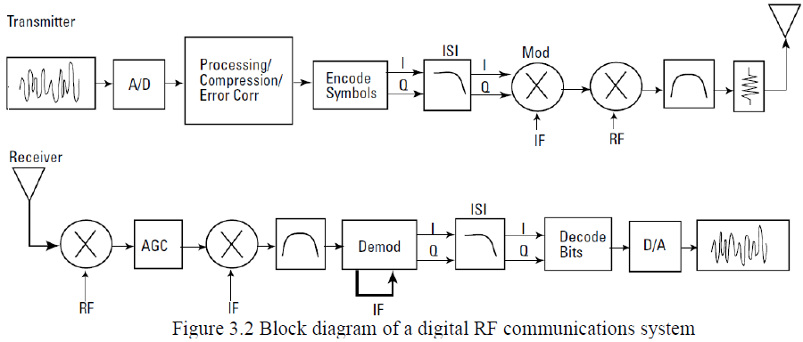
Technical Contents: System
Example 3: Communication System

Slide 7
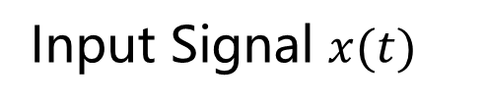
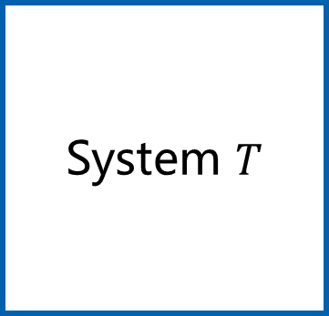
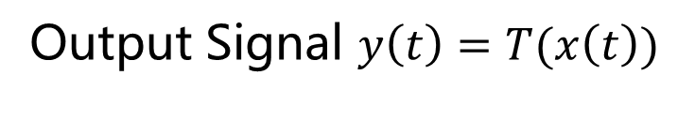
Technical Contents: System
What is a system?
A system is a mapping from an input signal to an output signal.
System $T$
Input Signal $x(t)$
Output Signal $y\left(t\right)=T(x\left(t\right))$
T: Transfer function 传输函数

Slide 8
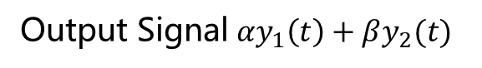

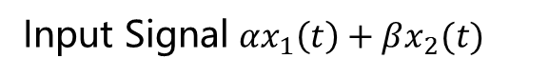
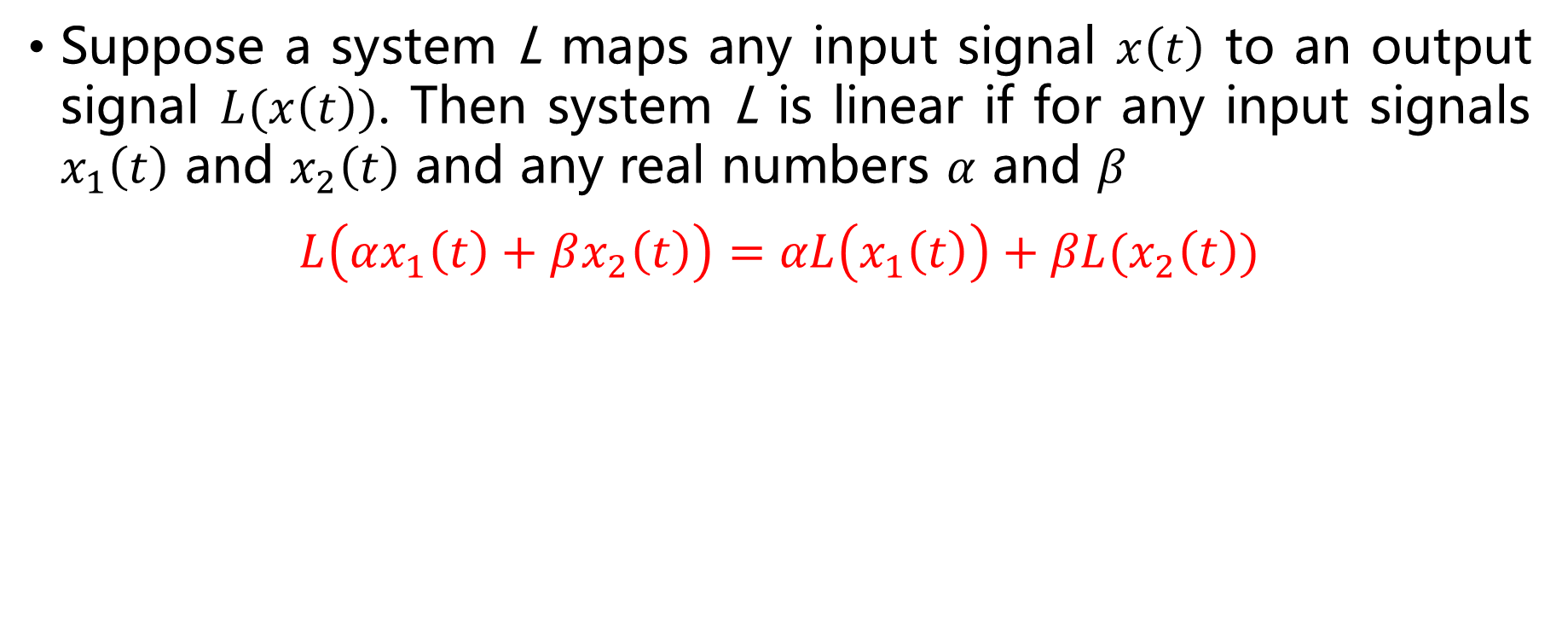
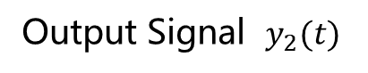

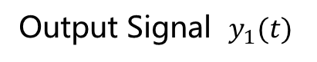
Technical Contents: Linear System
Suppose a system L maps any input signal $x\left(t\right)$ to an output signal $L(x\left(t\right))$. Then system L is linear if for any input signals $x_{1}\left(t\right)$ and $x_{2}\left(t\right)$ and any real numbers $α$ and $β$
$$L\left(αx_{1}\left(t\right)+βx_{2}\left(t\right)\right)=αL\left(x_{1}\left(t\right)\right)+βL(x_{2}\left(t\right))$$
Input Signal $x_{1}(t)$
System L
Output Signal $y_{1}(t)$
Input Signal $x_{2}(t)$
System L
Output Signal $y_{2}(t)$
Input Signal ${αx}_{1}\left(t\right)+βx_{2}(t)$
System L
Output Signal${ αy}_{1}\left(t\right)+βy_{2}(t)$

Slide 9
Technical Contents: Linear System
A system is nonlinear if it is not a linear system.

Slide 10



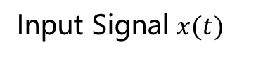

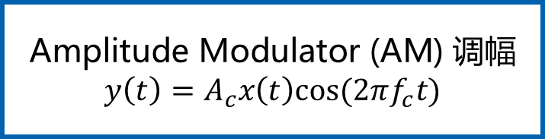


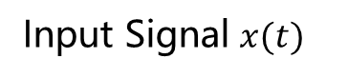
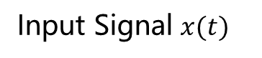
Typical Linear System
Input Signal $x(t)$
$\text{Amplifier}$ 放大器
$$y\left(t\right)=2x(t)$$
Output Signal $y(t)$
Input Signal $x(t)$
Differentiator 微分器
$$y\left(t\right)=\frac{dx\left(t\right)}{dt}$$
Output Signal $y(t)$
Input Signal $x(t)$
Integrator 积分器
$$y\left(t\right)=\int_{0}^{∞}{x\left(t\right)dt}$$
Output Signal $y(t)$
Input Signal $x(t)$
$\text{Amplitude} \text{Modulator}\text{ (}\text{AM}\text{) }$调幅
$$y\left(t\right)=A_{c}x\left(t\right)cos(2πf_{c}t)$$
Output Signal $y(t)$

Slide 11
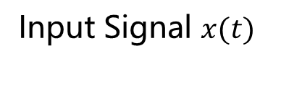
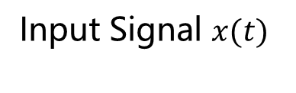
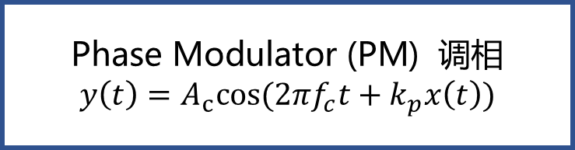


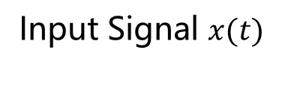
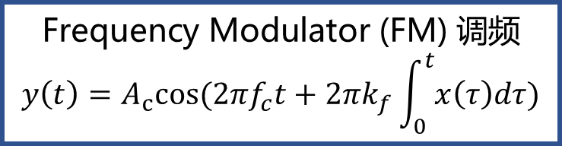


Typical Nonlinear System
平方
$$y\left(t\right)=x^{2}(t)$$
Input Signal $x(t)$
Output Signal $y(t)$
Input Signal $x(t)$
$\text{Phase} \text{Modulator}\text{ (}\text{P}\text{M}\text{) }$调相
$$y\left(t\right)=A_{c}cos(2πf_{c}t+k_{p}x\left(t\right))$$
Output Signal $y(t)$
Input Signal $x(t)$
$\text{F}\text{requency} \text{Modulator}\text{ (}\text{F}\text{M}\text{) }$调频
$$y\left(t\right)=A_{c}cos(2πf_{c}t+2πk_{f}\int_{0}^{t}{x\left(τ\right)dτ})$$
Output Signal $y(t)$

Slide 12
Radar System
目标
收发转换
发射机
天线
接收机
信号处理
显示器

Slide 13
Technical Terms
Antenna 天线
Transmitter 发射机
Receiver 接收机
Signal processing 信号处理
Display 显示器
Target 目标

Slide 14
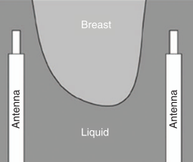
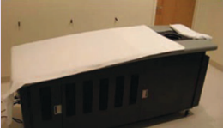
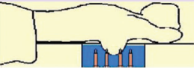
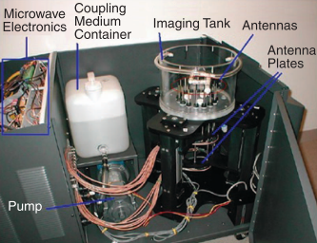
Radar System
(a)
(b)
达特茅斯学院探乳腺癌诊断微波成像实验平台[1]
(a)检测床实际图像
(b)实验平台使用简图
[1]N. K. Nikolova. Microwave imaging for breast cancer[J]. IEEE microwave magazine, 2011,12(7):78–94

Slide 15
Radar System
(c)
(d)
达特茅斯学院探乳腺癌诊断微波成像实验平台[1]
(c)实验平台容器构造简图
(d)实验平台各部分实际图像
[1]N. K. Nikolova. Microwave imaging for breast cancer[J]. IEEE microwave magazine, 2011,12(7):78–94

Slide 16
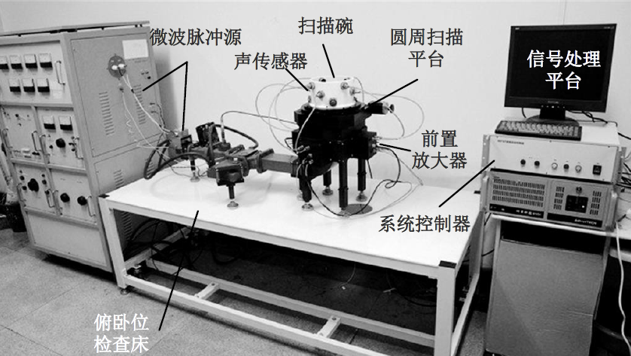
Radar System
微波热致超声成像系统实验系统实物图[2]
[2] 朱晓章. 非均匀介质中的目标成像[D]. 电子科技大学博士论文, 2014

Slide 17
Technical Terms
Radar | Ultra Acoustic/Acoustic Radar
Antenna 天线 | Transducer 换能器

Slide 18
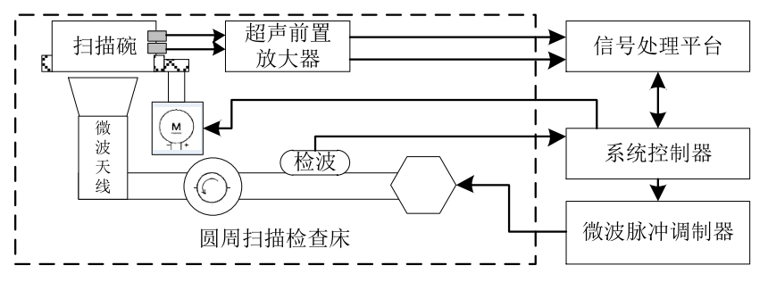
Radar System
超声探头
微波热致超声成像系统验系统框架简图[2]
[2] 朱晓章. 非均匀介质中的目标成像[D]. 电子科技大学博士论文, 2014

Slide 19
Technical Terms
amplifier 放大器
operational amplifier 运算放大器
low noise amplifier 低噪声放大器
gain 增益
bandwidth 带宽
GBP (Gain- Bandwidth Product) 增益带宽积
华为Mate30pro: 7680fps 超级慢动作拍摄

Slide 20
Technical Terms
由于信号微弱(Vpp<200uV)，为实现超声信号的采样和后期的数字信号处理，需要先对信号进行放大处理。
由于数据采集卡的输入信号动态范围是±2V，为降低量化过程引入的信噪比劣化，充分利用采集卡的分辨力，需要将信号放大到该范围。那么放大器的增益为 4V/200uV=20000
Gain：86dB (20000倍)
Bandwidth: 50KHz~8MHz
GBP： 160GHz
华为Mate30pro: 7680fps 超级慢动作拍摄

Slide 21
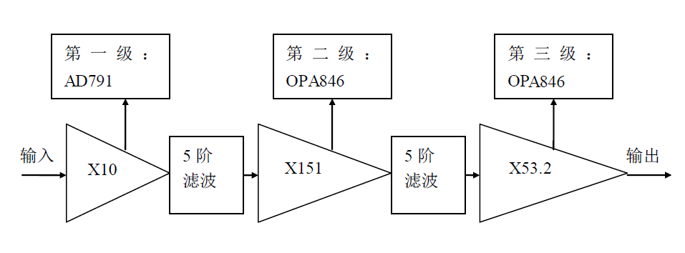
Technical Terms
放大器结构示意图
由于第二级和第三级放大器的输入端均有滤波器，而滤波器的阻抗匹配（源阻抗与负载阻抗均为50 Ohm）会带来6dB的增益损失，因此后两级放大器需要补偿该损失。那么整个放大器的实际增益为：10×(151/2)×(53.2/2)=20083

